Slide 1


Establishment of the Iran National Obesity Registry: Infrastructure, Implementation, and Impact
(IRNOR)
Prof. Majid Ghayour-Mobarhan
MD, MSc, Ph.D.
Professor of Clinical Nutrition,
Founder of International UNESCO Center for
Health Related Basics Sciences and Human Nutrition,
Founding Member of Metabolic Syndrome Research Center, MUMS, Mashhad, Iran.
Honorary professor of Macquarie University, Sydney, Australia.
Notes:
By GAM98

Slide 2

Outline
Introduction & Definitions
Registry Objectives
Global Experiences
IRNOR Overview
Minimum Dataset (MDS)
Software & Methodology
Statistical Findings
Intervention Evaluation
Achievements & Challenges
Future Perspectives

Slide 3
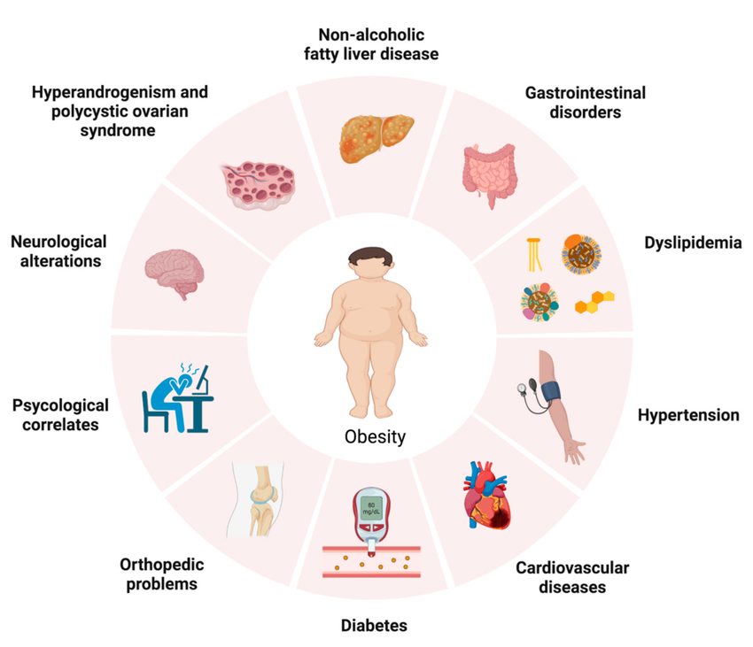

Obesity and Overweight
Abnormal or excessive fat accumulation in various parts of the body.
Overweight: BMI ≥ 25 and < 30 kg/m²
Obesity: BMI ≥ 30 kg/m²
Overweight & Obesity Trends (2020–2035)
Overweight adults: 1.39B → 1.77B
Obese adults: 0.81B → 1.53B
Adult prevalence: 42% → 54%
Spectre Template
World Obesity Federation, 2023

Slide 4
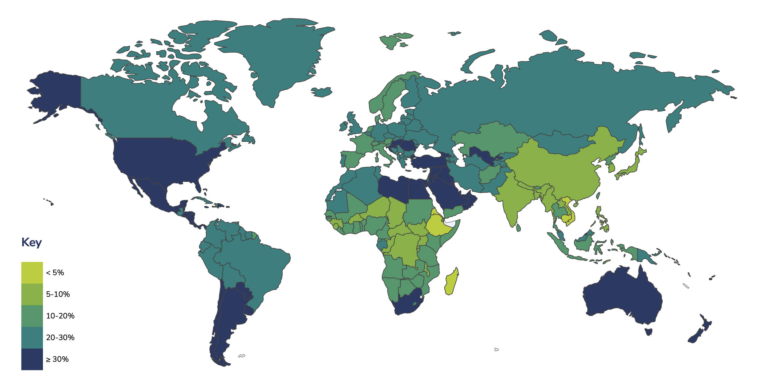
Prevalence of Overweight and Obesity Among Adults:IRAN 2024
IRAN
Obesity:25.1%
Overweight:62.1%
World Obesity Atlas 2024

Slide 5

Role of Registries in Obesity Management
Chronic diseases, including obesity, require long-term and systematic monitoring.
Registries provide structured data to support:
  Clinical monitoring and follow-up
  Improved patient management
  Development of evidence-based clinical policies
Spectre Template
Gliklich RE, et al. 2020

Slide 6

Need for a National Obesity Registry
Lack of a national obesity registry for systematic and continuous patient data collection
Difficulty in planning targeted prevention and treatment strategies
Limited studies evaluating the effectiveness of interventions
Rising prevalence of obesity and related diseases
Need for local, population-based data in Iran to design effective strategies

Slide 7
Objectives of the Obesity registry
Register adults with overweight and obesity and evaluate dietary therapy outcomes
Provide a platform for designing and conducting research
Develop infrastructure for participation in international registries
Assess effectiveness of different treatment modalities
Identify factors influencing long-term weight loss and maintenance
Gliklich RE et al. 2020
NA Dreyer et al. 2009

Slide 8

Obesity Registries
NWCR
National Weight Control Registry
Medweight registry
In USA
Started in 1994 until now
More than 10000 enrollments
> 18 years
1
4
In Greece
Started in 2012
18-65 y
POWER
Pediatric Obesity Weight Evaluation Registry
CANPWR
CANadian Pediatric Weight management Registry
2
5
In USA
Started in 2008
10683 enrollments
2-18 y
In Canada
Started in 2013
1600 enrollments
2-17 y
Portuguese Weight
Control Registry
3
6
Greek registry
In Portuguese
Started in 2008
388 enrollments
18-65 y
In Greece
Started in 2015
1270 enrollments
2-18 y

Slide 9

Long-Term Weight Maintenance Strategies
Dietary Patterns
Consistent eating patterns throughout the week
Regular breakfast consumption
Smaller portions with more frequent meals
Lower refined carbohydrate intake, higher protein intake
Adherence to Mediterranean diet and MyPlate model
Behavioral Strategies
Regular self-monitoring of weight and food intake
Slower eating and control of emotional overeating
Clear goal setting
Physical Activity
High levels of regular physical activity
Walking instead of motorized transport
Combined diet + physical activity programs show greater effectiveness
Lifestyle Factors
Healthier overall lifestyle (less smoking and alcohol use)
Better sleep quality
Thomas JG, et al. 2014.www. Internationalweightcontrolregistry.org. Wing RR, et al. 2001. Thomas JG, et al. 2011. Klem ML, et al. 1997. Roberts SB, et al. 2022
Santos I, et al. 2017. Vieira PN, et al. 2013. Feller S, et al. 2015. Hübner C, et al. 2016. Neumann M, et al. 2018. Soini S, et al. 2016. Soini S, et al. 2018. Yannakoulia M, et al. 2017. Poulimeneas D, et al. 2020. Brikou D, et al. 2016. Karfopoulou E, 2014. Karfopoulou E, et al. 2016. Karfopoulou E, et al. 2017. Cha J, et al. 2022. Ko MM, et al. 2022.

Slide 10


Long-Term Weight Maintenance Strategies
3
1
Design and implementation of the first national adult obesity registry in Iran
Long-term follow-up of patients for obesity management
Innovation
Establishment of a national infrastructure for future research and health policy development
Development of a dedicated registry platform
4
2

Slide 11
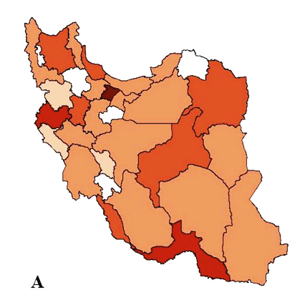
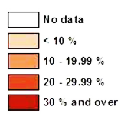
Iranian National Obesity Registry
(IRNOR)
2017
Bmi≥ 25
&
≥ 18 year

Slide 12
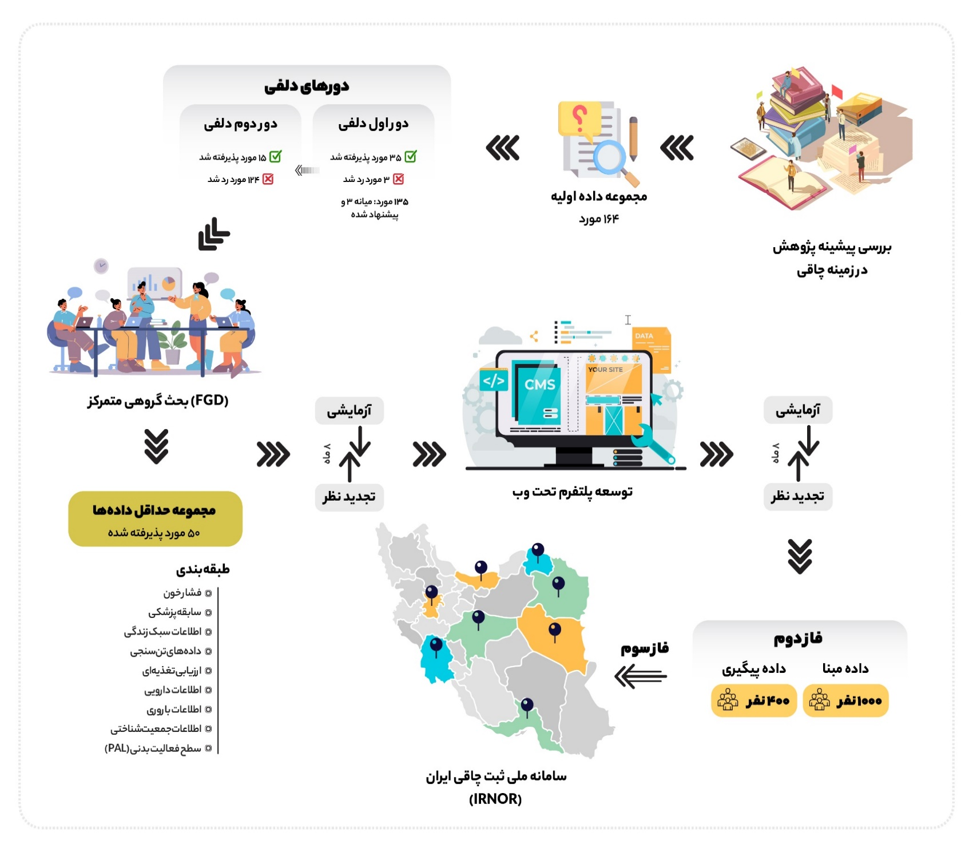
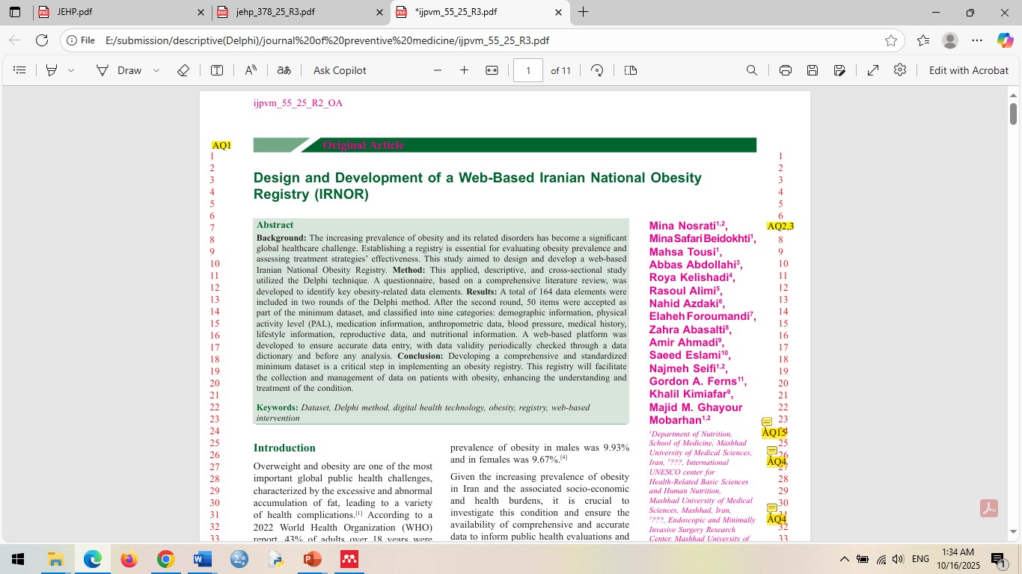
An overview of phases 1 and 2
Delphi Rounds
Second Delphi Round
First Delphi Round
15 items accepted
15 items accepted
35 items accepted
124 items rejected
3 items rejected
135 items: median score of 3 and recommended for reconsideration
Initial data set
164 items
Review of Previous Research in Obesity
Focus Group Discussion (FGD)
Pilot Phase
Pilot Phase
Pilot Phase
8 months
8 months
8 months
Revision
Development of a web-based platform
Revision
Minimum Data Set (MDS)
50 items approved
Revision
Classification
Blood pressure
Medical history
Lifestyle information
Anthropometric data
Nutritional assessment
Medication information
Reproductive information
Demographic information
Physical activity level
Phase II
Phase III
Phase II
Follow-up data
Baseline data
400
1000
Iran National Obesity Registry System
(IRNOR)

Slide 13





An overview of phases 3
Minimum Data Set Review:
Assess data quality (consistency, accuracy, completeness)
Conduct focus group sessions with nutrition and health information management experts
Categorize data elements into 7 groups
Registry Website Development:
Design of the Angabin Teb website
Design of the Regim 24 website
Implementation through the Rabbit System platform
Data Collection:
In-person method: Data recorded by the registry expert
Remote method: Online form completed by the participant
Data Dictionary Review:
Complete data dictionary forms for new items
Define input type (text, number, checkbox, file)
Engagement of Centers:
Public call for participation and organization of workshops
Signing 21 memoranda of understanding (MOUs) with universities and healthcare centers
Providing system access and training registry teams

Slide 14

Phase 3
IRANIAN NATIONAL OBESITY REGISTRY (IRNOR)
Collaborating with 22 sites
1
Collected 9000 baseline and 3000 follow up data
2
3
Statistics analysis (SPSS, Machine learning, Neural network)
15 publication
4
Improvement of software

Slide 15
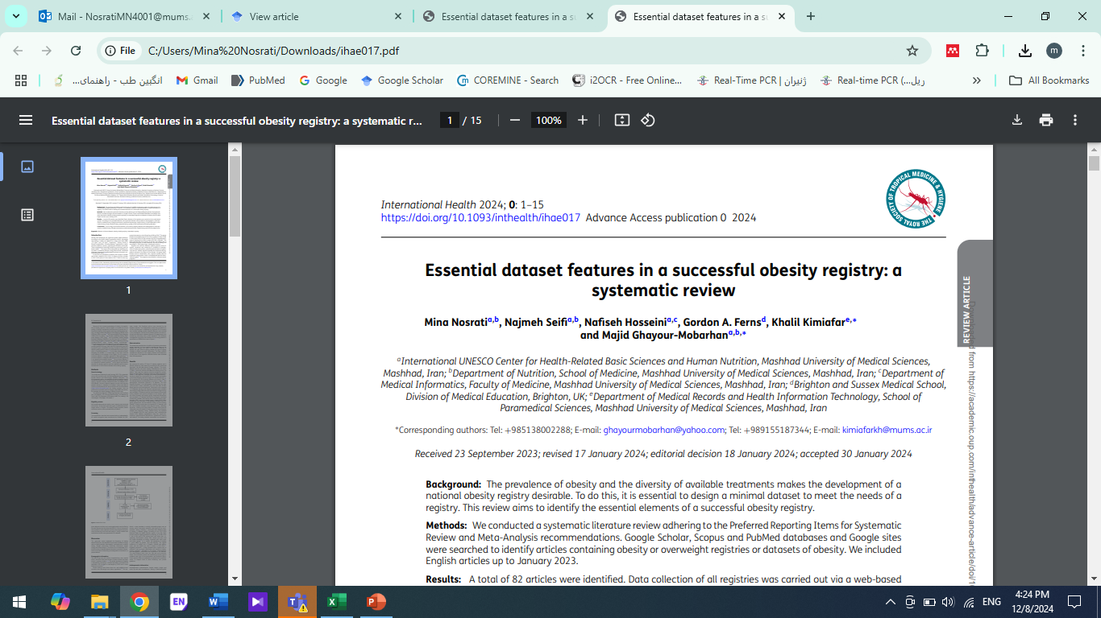
Phase 3 Essential Dataset Review:
Reviewed Phase 2 data quality and the study by Nosrati et al.
Participants: 9 nutrition specialists, 2 health IT experts, and 2 data registration officers
Removed 14 items due to low completion rates and incomplete records:
Drug dose, drug administration method, drug form
Type and amount of tobacco use
Type and amount of illicit drug use
Type and amount of alcohol consumption
Waist circumference, hip circumference
Systolic and diastolic blood pressure
24-hour dietary recall
36 items retained in the essential dataset

Slide 16
Obesity Registry dataset
Obesity registry dataset has 9 categories
Demographic
&
Physical activity
Anthropometric
&
Blood pressure
&
Clinical analysis
Medical
&
medication
History
Nutritional
assessment
Questions related
to women
&
Drug abused
Sex, Age
Marital status
Job
Education level
Physical activity level
Weight
Height
Waist circumference
Blood pressure
CBC, hormonal, mineral, vitamin
Diet history
Appetite status
Speed of meal
Eating disorder
Number of meal
Main meal
CVD, diabetes, hypertension, fatty liver, other complication
Pregnancy, abortion, lactation
Smoking
Drinking

Slide 17
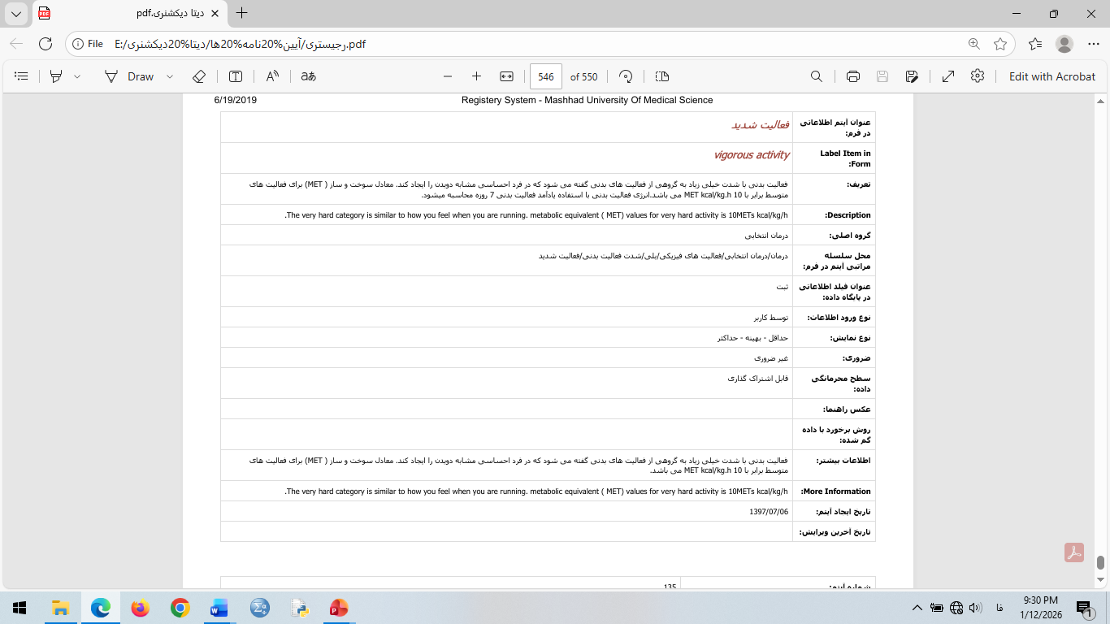
Data Dictionary Review Based on the University’s Research Affairs Forms

Slide 18

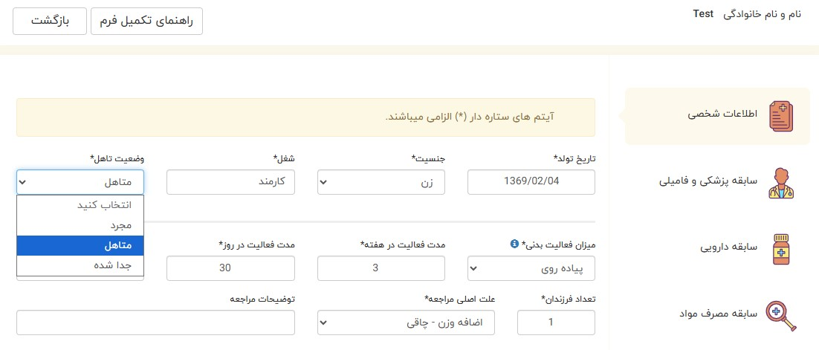
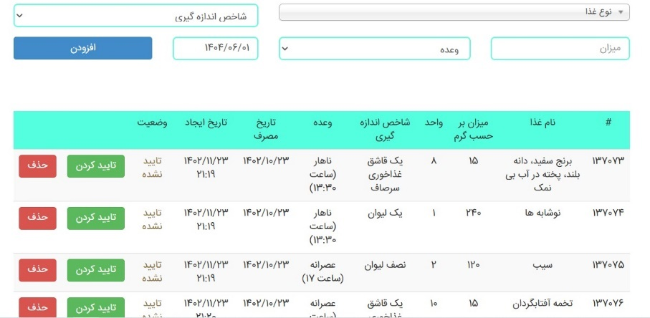
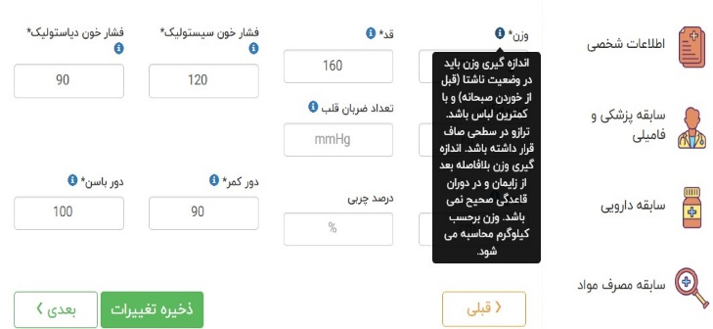
Registry System Design
Borna System
2,500 food items, including Iranian and international foods, based on the Food Composition Tables
Diet Therapy Panel
Angabin Teb Website
Regim 24 Website
Rabit System

Slide 19
Center Participation
Regional Health Center: Khorasan Razavi
Registry introduction
Memorandum of understanding (MoU)
Training
Access to the registration system
Public Centers: Bank Maskan, Bank Melli
National
Private Centers: Clinics and private practices
Universities
COMSTECH Registry
International

Slide 20
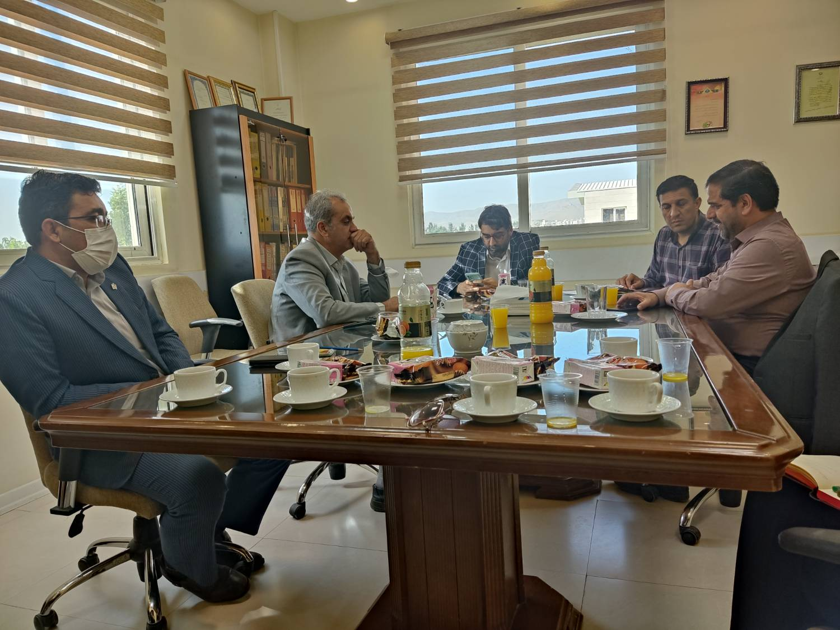
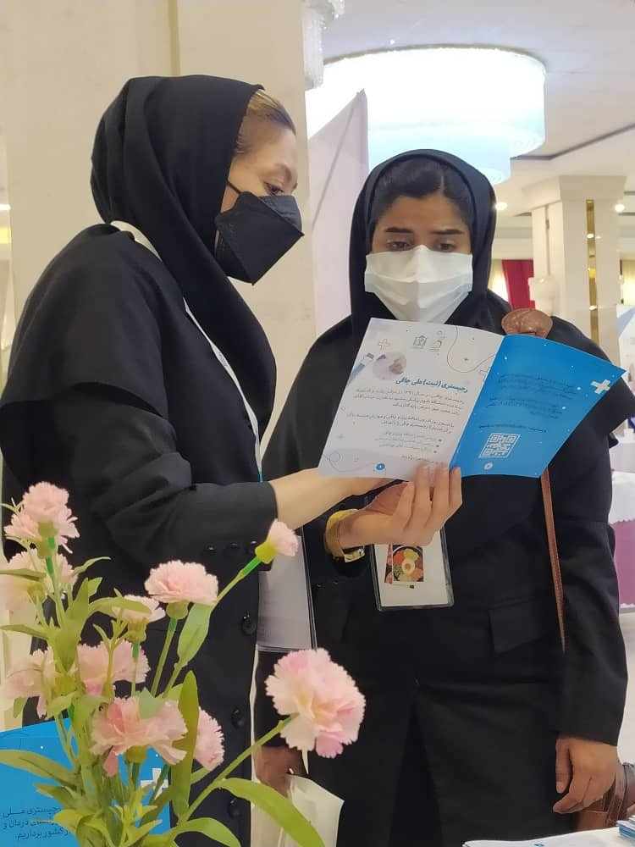
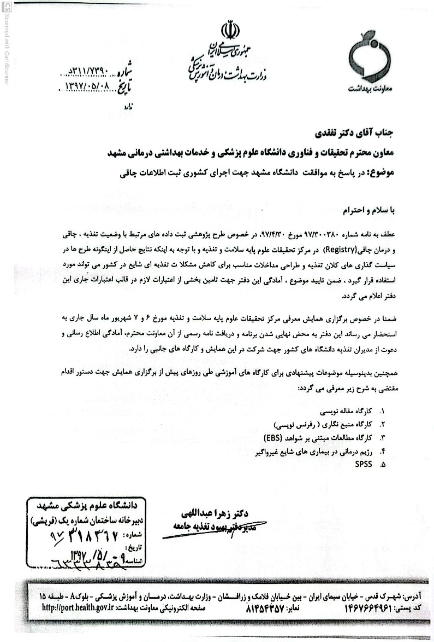
Center Participation

Slide 21
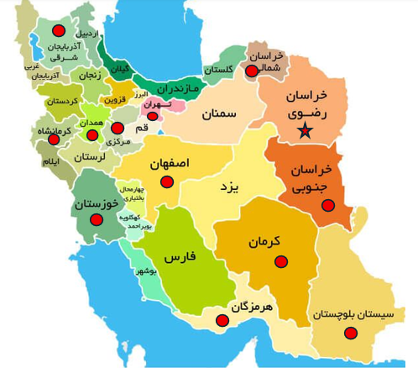
Participating Sites
Number of records | Registrations by Active Obesity Registry Centers
3151 | Mashhad & Health Center
2000 | Qaemshahr
704 | Torbat Heydariyeh
375 | Birjand
227 | Qaem Hospital Research Center
241 | Sabzevar
208 | Kashan
145 | Isfahan
76 | Abadan
70 | Bandar Abbas
41 | Malayer
35 | Bojnord
Overall Registrations:
Initial registrations: 7,273
Follow-ups: 2,728
24-hour dietary recalls: 3,987
Laboratory tests: 1,096
Data from weight-loss devices: 45
No Implementation Costs
MoUs Signed With: Khomein, Nishapur, Zabol, Jiroft, Tabriz, Kermanshah, Gonabad

Slide 22
Phase 3 Data Collection
Informed consent
In-person (staff)
Remote/online (user)
Type of Registration
1
Registry form
24-hour dietary recall
Laboratory reports
Anthropometry (INBODY 720/770, scale, stadiometer)
Baseline Registration
2
Paper forms and Rezhim 24 website
Anthropometry (weight, waist circumference, BIA device outputs)
Prescribed diet type, physical activity, weight-loss supplements and medications, laboratory adverse events
Follow-up Registration
3

Slide 23
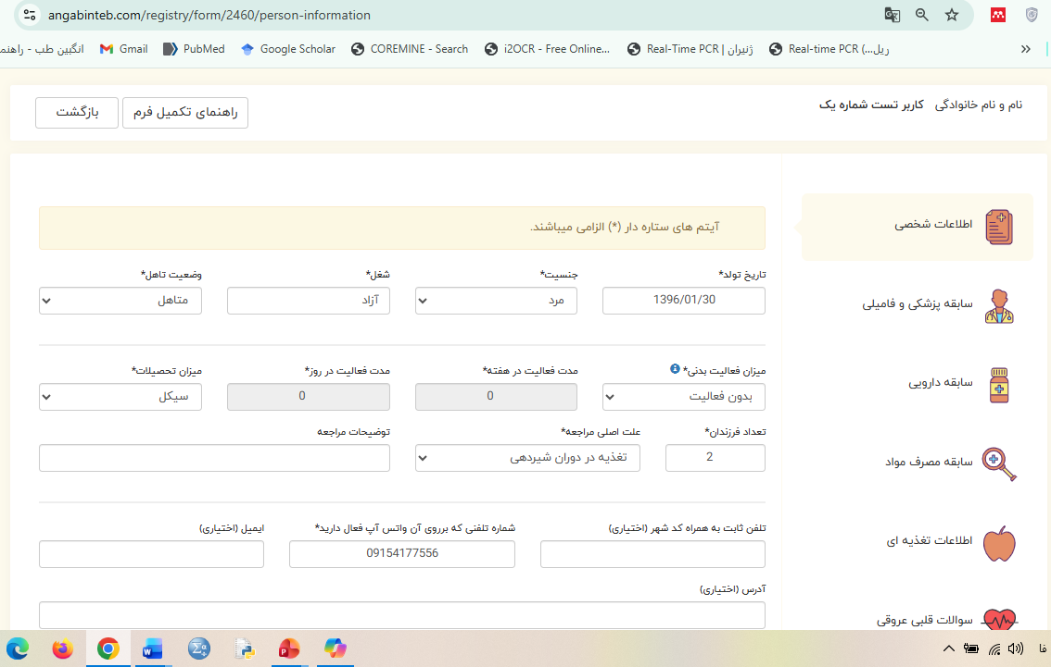
Phase 3 Data Collection

Slide 24
Phase 3 Data Collection
شماره همراه | کد ملی | تاریخ مراجعه | نوبت مراجعه | نام و نام خانوادگی
وزن: قد: دورکمر: دور باسن: نوع درمان: رژیم درمانی دارودرمانی فعالیت فیزیکی دستگاه لاغری موضعی جراحی طب سوزنی بالن نوع رژیم: رژیم محدودکننده کالری رژیم خیلی کم کالری رژیم کتوژنیک رژیم با چربی خیلی پایین رژیم با شاخص گلایسمیک پایین سایر داروی مورد استفاده: اورلیستات (زنیکال) بنزفتامین دی اتیل پروپیون فن ترمین لورکاسرین فن دی مترازین فنترمین-توپیرامات بوپروپیون- نالترکسون لیراگلوتاید بوپروپیون توپیرامات لامتوریژین سیبوترامین فلوکستین مت فورمین سایر مکمل لاغری مورد استفاده: Bitter orange Chromium Country mallow (heartleaf) Green tea extract Raspberry ketones Hoodia Garcinia Cambogia Mango slim Slim quick Chitosan Qsymia, by qualified G Tisazio CLA Ephedra (Ma Huang) Guar gum Senna Rugreen hazal سایر فعالیت فیزیکی: پیاده روی فعالیت متوسط فعالیت شدید تعداد روز در هفته دقیقه در روز عوارض رژیم درمانی: ناراحتی عصبی ریزش مو خشکی پوست کم خونی احساس ضعف کاهش وزن استخوان اختلال قاعدگی احساس گرسنگی شدید تحلیل عضلانی افت فشارخون بوی بد دهان احساس خستگی کرامپ عضلانی سایر عوارض دارو درمانی: افزایش ضربان قلب افزایش فشارخون بی خوابی عصبانیت سردرد سرگیجه ضعف تهوع گرفتن عضلات شکم اسهال تغییر مزه دهان طعم مزه فلزی در دهان خشکی دهان بی حسی پوست مشکلات کبد عوارض پوستی غش کردن درد شکمی سایر عوارض مکمل های لاغری: اسهال یبوست ورم کردن مچ دست ورم کردن مچ پا افزایش حجم مدفوع نفخ سوزش معده تهوع سردرد کرامپ های شکمی سرفه سایر طریقه مصرف دارو نام دارو( ) : طول دوره مصرف مقدار مصرف تعداد مصرف نحوه مصرف نام دارو( ) : طول دوره مصرف مقدار مصرف تعداد مصرف نحوه مصرف نام دارو( ) : طول دوره مصرف مقدار مصرف تعداد مصرف نحوه مص

Slide 25
Dietary Intervention Protocol
Clinical conditions, nutritional assessment, dietary preferences, and dietitian’s diagnosis
Calorie restriction
Ketogenic
Paleo
Intermittent fasting
Assessment of adherence to the diet
Observation of weight loss or changes in body composition, patient self-report on following nutritional recommendations, continued visits to the dietitian
Follow-up of participants during the intervention period, every 2 to 4 weeks

Slide 26
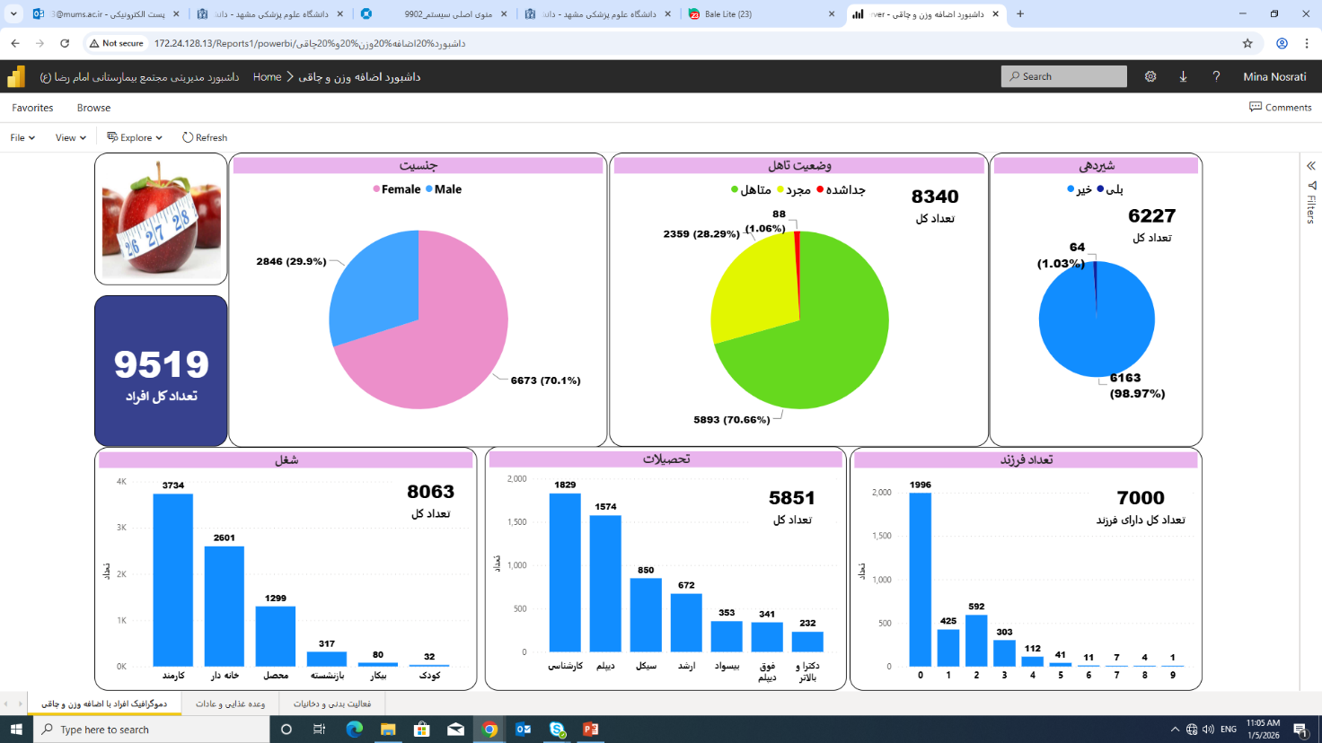
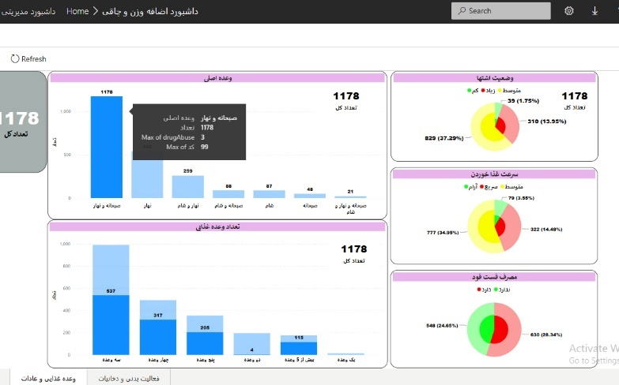



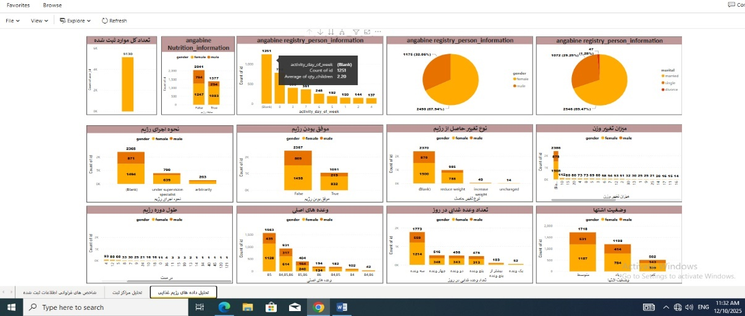
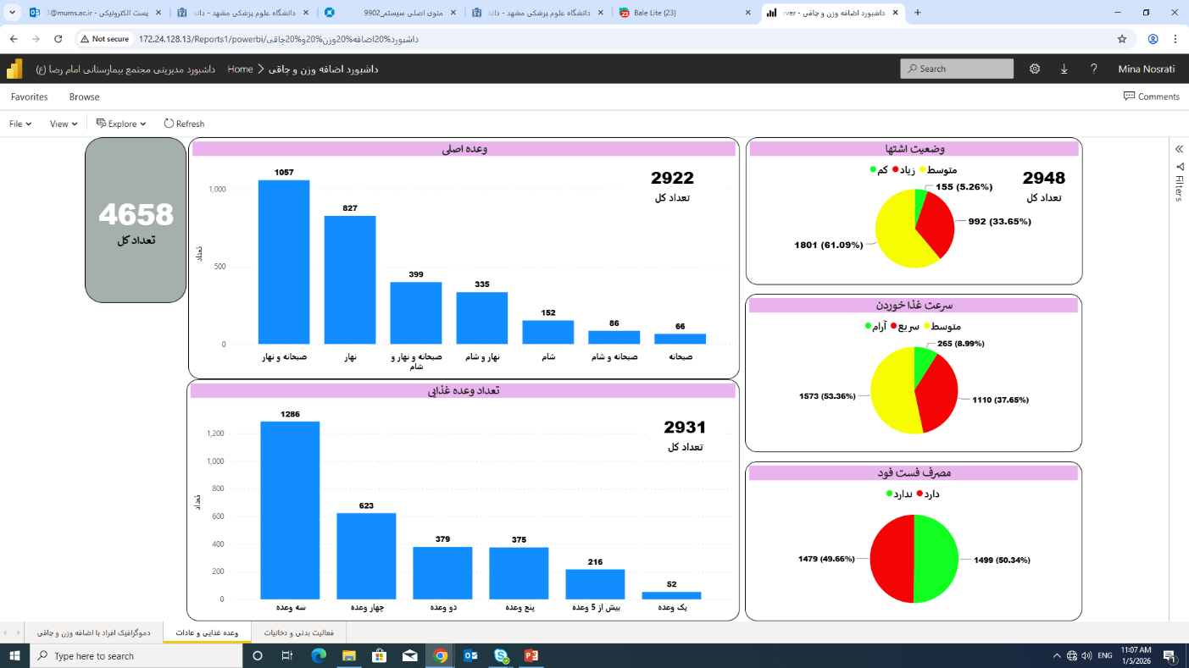
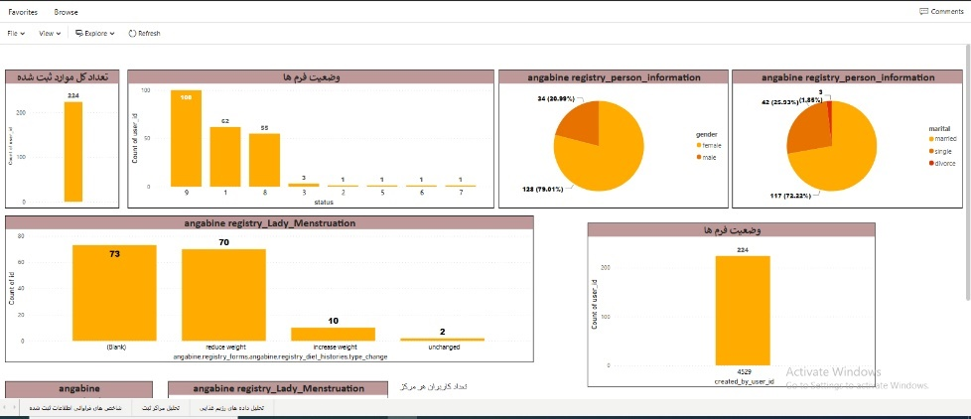
Registry Data Quality Control
Quality control of at least 10% of all annual registry entries
Data dictionary
Staff training, including instructional videos and standard protocol manuals
Registry dashboard

Slide 27
Frequency distribution of completed essential obesity registry items
Data Report
On average, 87.85% of the registry dataset was completed.
آیتم | تعداد (درصد) | آیتم | تعداد (درصد)
نام و نام خانوادگی | 7148 (100) | نام دارو | 7148 (100)
کدملی | 7148 (100) | بارداری | 7148 (100)
شماره تلفن | 7148 (100) | فعالیت بدنی | 5862 (82.00)
سن | 7148 (100) | تعداد روز فعالیت بدنی در هفته | 5363 (75.02)
جنس | 7148 (100) | دقیقه فعالیت بدنی در روز | 5363 (75.02)
شغل | 6098 (85.31) | مصرف دخانیات | 6480 (90.65)
علت مراجعه | 7148 (100) | مصرف الکل | 6519 (91.20)
سطح تحصیلات | 4316 (60.38) | سوءمصرف مواد | 5008 (70.06)
وزن | 7148 (100) | سرعت غذاخوردن | 4883 (68.31)
قد | 7148 (100) | میزان اشتها | 4858 (67.96)
تاریخچه پزشکی | 7148 (100) | تعداد وعده‌های غذایی | 4787 (66.96)

Slide 28
Frequency distribution in the obesity registry
Data Report

Slide 29
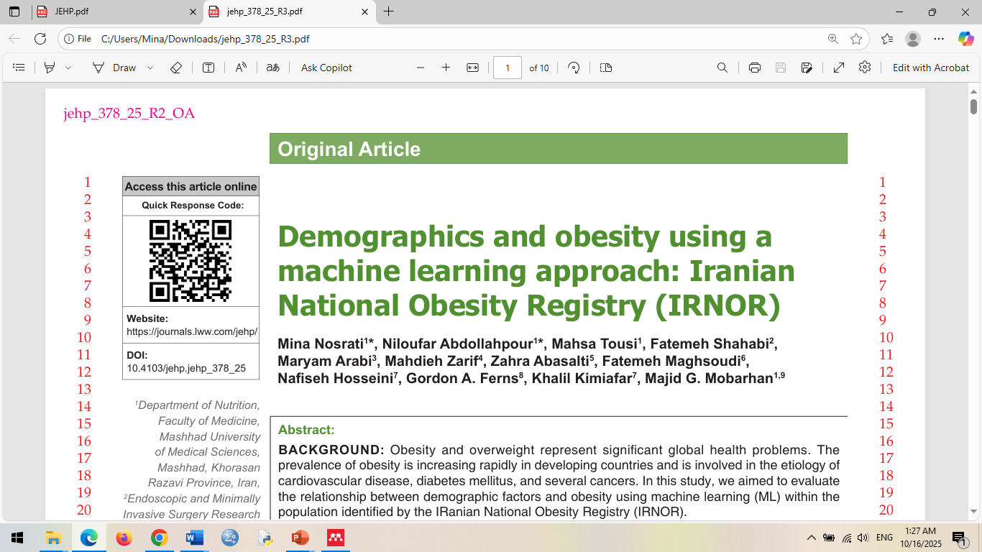
Association of background variables with BMI
Data Report
متغیر | B | Std. Error | t | p-value | 95%CI
شغل
کارمند | 0 | - | - | - | -
خانه‌دار | 1.20 | 0.22 | 5.31 | 0.001> | 1.64 -0.75
بیکار | 0.15 | 0.31 | 0.47 | 0.63 | 0.77 – 0.47-
بازنشسته | 0.40- | 0.41 | 0.99 | 0.31 | 0.39 – 1.21-
تحصیلات
بیسواد و سیکل | 0 | - | - | - | -
دیپلم و فوق دیپلم | 0.73- | 0.24 | 3.00 | 0.003 | 0.25- - 1.21-
کارشناسی و کارشناسی ارشد | 1.31- | 0.26 | 5.03 | 0.001> | 0.80- - 1.82-
دکتری و بالاتر | 2.29- | 0.43 | 5.22 | 0.001> | 1.43- - 3.15-
تعداد فرزند
ندارد | 0 | - | - | - | -
3-1 فرزند | 0.73 | 0.20 | 3.58 | 0.001> | 1.13- 0.33
بیش از 3 فرزند | 1.57 | 0.35 | 4.40 | 0.001> | 2.27 – 0.87
سابقه دریافت رژیم غذایی ندارد | 0 | - | - | - | -
سابقه دریافت رژیم غذایی دارد | 2.03 | 0.16 | 12.13 | 0.001> | 2.36 – 1.70
سرعت غذاخوردن
معمولی | 0 | - | - | -- | -
آهسته | 0.20 | 0.26 | 0.78 | 0.43 | 0.71 – 0.30-
سریع | 0.94 | 0.17 | 5.32 | 0.001> | 1.29 – 0.59

Slide 30
Frequency distribution of participants across time intervals and by diet type (follow-up phase)
Data Report

Slide 31
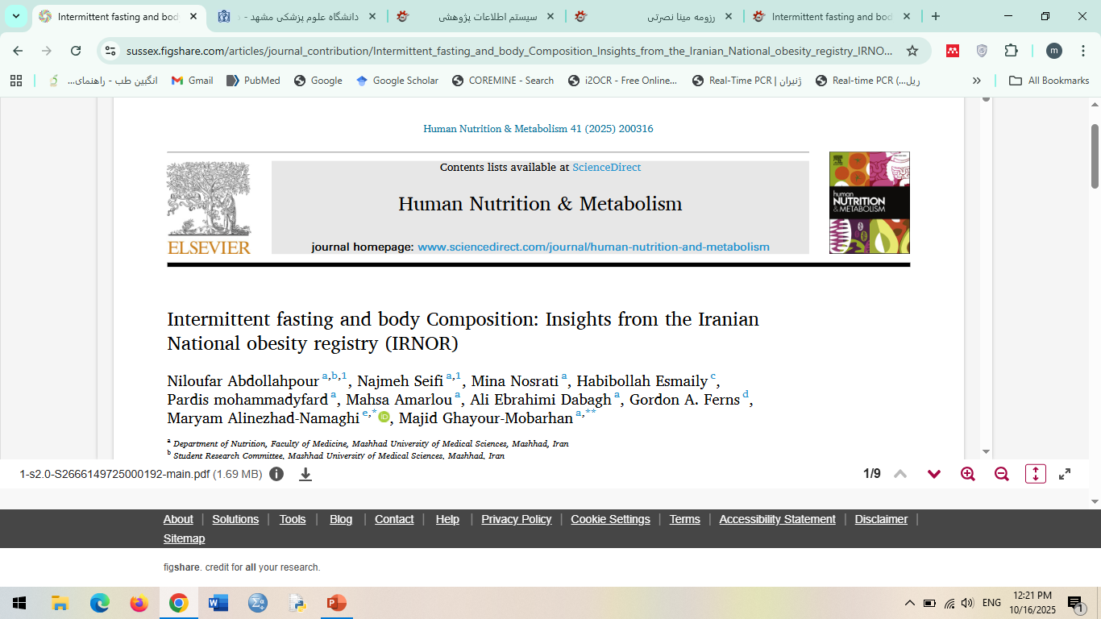
Evaluation of the effectiveness of dietary therapy on anthropometric variables and body composition indices using the GEE model
Data Report
تعدیل شده با سن، جنسیت، مقادیر اولیه، مصرف مکمل، در هر ردیف حروف غیرهمنام معنادار می باشد.

Slide 32
Evaluation of the effectiveness of dietary therapy on anthropometric variables and body composition indices using the GEE model
Data Report
تعدیل شده با سن، جنسیت، مقادیر اولیه، مصرف مکمل، در هر ردیف حروف غیرهمنام معنادار می باشد.

Slide 33
Evaluation of the effectiveness of dietary therapy on anthropometric variables and body composition indices using the GEE model
Data Report
تعدیل شده با سن، جنسیت، مقادیر اولیه، مصرف مکمل، در هر ردیف حروف غیرهمنام معنادار می باشد.

Slide 34
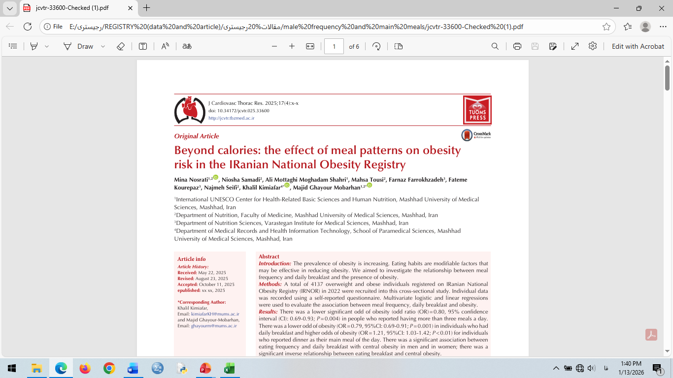
Association of background factors with weight loss and long-term weight maintenance
Data Report

Slide 35
Evaluation of intervention effectiveness on anthropometric variables and body composition indices using the GEE model
Data Report

Slide 36
Assessment of the effectiveness of interventions on anthropometric variables and body composition indices using the GEE model
Data Report

Slide 37
Data Report (Dietary Intake)
p-value* | Overweight Mean ± SD | Obesity Mean ± SD | Total Mean ± SD | variable
0.81 | 893.62 ± 1856.30 | 924.48 ± 1865.36 | 914.46 ± 1862.43 | Energy (kcal)
0.015 | 45.15 ± 81.92 | 44.27 ± 77.22 | 44.60 ± 78.74 | Protein (g)
0.96 | 35.37 ± 57.09 | 36.02 ± 57.16 | 35.81 ± 57.14 | Fat (g)
0.46 | 169.01 ± 264.41 | 168.55 ± 269.73 | 168.68 ± 268.01 | Carbohydrate (g)
0.71 | 13.35 ± 18.45 | 14.40 ± 18.67 | 14.07 ± 18.60 | SFA(g)
0.05 | 10.81 ± 12.16 | 12.59 ± 13.11 | 12.05 ± 12.80 | PUFA(g)
0.28 | 186.49 ± 224.82 | 215.66 ± 233.86 | 206.70 ± 230.94 | Cholesterol (g)
0.06 | 72.21 ± 122.02 | 83.75 ± 128.34 | 80.25 ± 126.30 | Starch (g)
0.11 | 7.94 ± 12.35 | 9.79 ± 12.98 | 9.24 ± 12.78 | Fiber (g)
0.19 | 57.07 ± 61.16 | 52.41 ± 64.23 | 53.96 ± 63.24 | Total sugar (g)

Slide 38
Data Report (Biochemical parameters)
p-value* | Overweight Mean ± SD | Obesity Mean ± SD | Total Mean ± SD | Variable
0.017 | 23.10 ± 99.67 | 28.50 ± 104.04 | 26.94 ± 102.63 | FBG (mg/dL)
0.50 | 1.67 ± 5.94 | 1.39 ± 5.84 | 1.48 ± 5.87 | HbA1C (%)
0.59 | 9.40 ± 26.39 | 8.35 ± 26.88 | 8.73 ± 26.71 | Urea (mg/dL)
0.08 | 0.22 ± 0.86 | 0.49 ± 0.92 | 0.41 ± 0.90 | Cr (mg/dL)
0.19 | 1.39 ± 5.09 | 1.58 ± 5.30 | 1.52 ± 5.24 | Uric Acid (mg/dL)
0.007 | 36.78 ± 185.58 | 41.40 ± 193.65 | 40.04 ± 190.89 | Cholesterol (mg/dL)
0.0001> | 67.16 ± 132.45 | 82.21 ± 155.77 | 78.24 ± 147.99 | TG(mg/dL)
0.33 | 10.60 ± 46.52 | 10.00 ± 45.70 | 10.21 ± 45.98 | HDL(mg/dL)
0.0001> | 28.29 ± 99.74 | 34.13 ± 108.83 | 32.61 ± 105.89 | LDL(mg/dL)
0.009 | 8.83 ± 21.66 | 9.47 ± 23.69 | 9.30 ± 22.99 | AST (IU/L)
0.035 | 15.61 ± 23.94 | 18.68 ± 27.08 | 17.74 ± 26.01 | ALT (IU/L)
0.0001> | 0.83 ± 1.42 | 1.80 ± 2.32 | 1.58 ± 1.99 | CRP(mg/dL)
0.107 | 1.75 ± 2.35 | 2.05 ± 2.65 | 1.97 ± 2.56 | TSH (µIU/mL)

Slide 39
Follow up result
*
**
**
**
**
**
**
**

Slide 40
Follow up result
*
***
**
***
*
*
***
*

Slide 41
Follow up result
***
***
*
*
*
***
***
***
***
***
***
***
***

Slide 42

The importance of registries in health policy-making, monitoring, resource allocation, and cost-effective knowledge generation
Monitoring the diverse services and interventions provided within the country’s healthcare system
Registries:
Cost-effective
Real-world data–based
Foundation for health policy-making
Monitoring, evaluation, and prioritization of interventions
Selecting tools for knowledge generation and decision-making that are both effective and economically efficient
Resource allocation without real-world data in chronic diseases,
Risk of wastage
Franklin JM, et al. 2017. AHRQ Methods for Effective Health Care. 2020.

Slide 43
Strengths and Limitations of the Obesity Registry
Strengths
First real-world clinical registry for adult obesity in Iran
Comprehensive data: anthropometry, nutrition, lifestyle, follow-up, labs
Long-term follow-up available
Digital health tools and dedicated dashboard
Integration of behavioral, nutritional, and body composition data for personalized treatment insights
Limitations
Missed follow-up visits → incomplete data
Incomplete forms and many dietary recalls removed
Limited lab data due to lack of data-sharing infrastructure
Self-reported data limits full validation
Normal-weight individuals not included for comparison

Slide 44
Projects
1 PhD theses
11 Master’s theses
3 Research projects
1 NIMAD grant
24 articles to date

Slide 45

Ongoing Projects and Proposals
Ongoing Actions
Children’s registry
Elderly registry
Enhancement of registry dashboard (NIMAD grant)
COMSTECH registry project
University of Tehran project
Registry for weight-loss supplements and medications
Registry for localized slimming devices
Establishment of a national data-sharing system
Standardization and monitoring of private nutrition service platforms
System-based and supportive strategies to improve patient adherence to treatment
Proposals

Slide 46

Challenges
High initial setup costs, including IT infrastructure, form design, staff training, servers, and data security requirements
Ongoing maintenance costs, including software updates, technical troubleshooting, monitoring, and data storage
Lack of sustainable funding, reliance on short-term or project-based budgets
Frequent management changes and breach or discontinuity of collaboration agreements
Shortage of trained and permanent staff at partner centers, leading to discontinuation of participation by some centers
Weak data-sharing systems

Slide 47
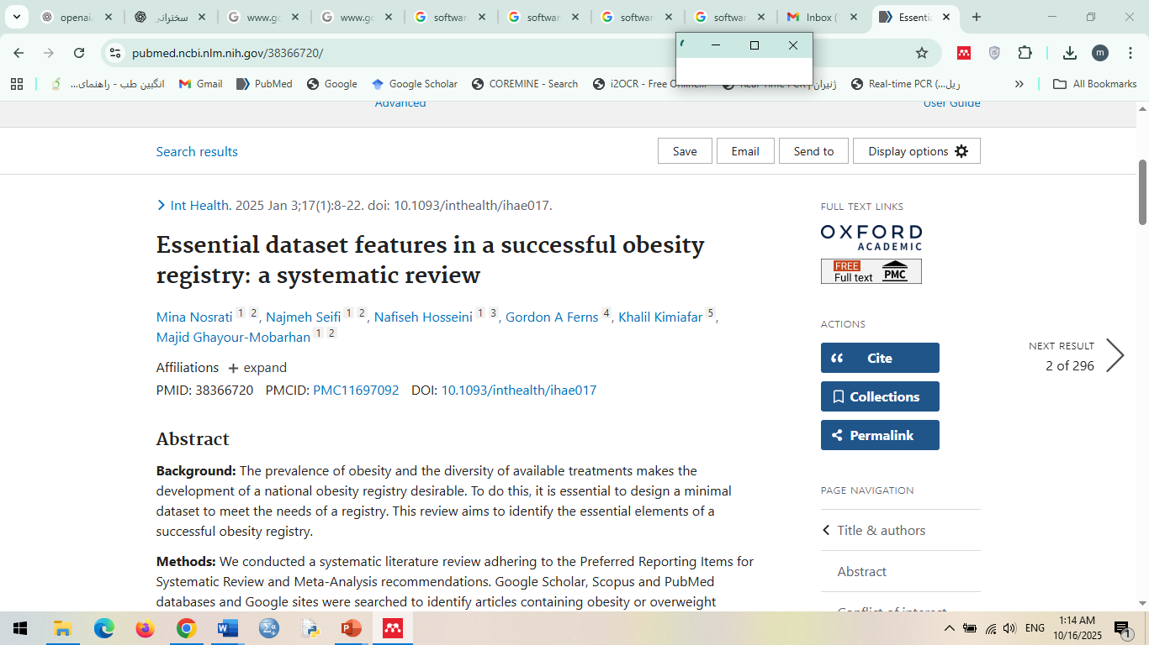
Publications

Slide 48
Publications

Slide 49
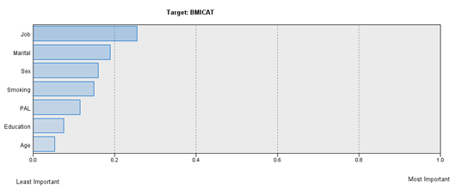
Publications
Risk factor importance of SVM model

Slide 50
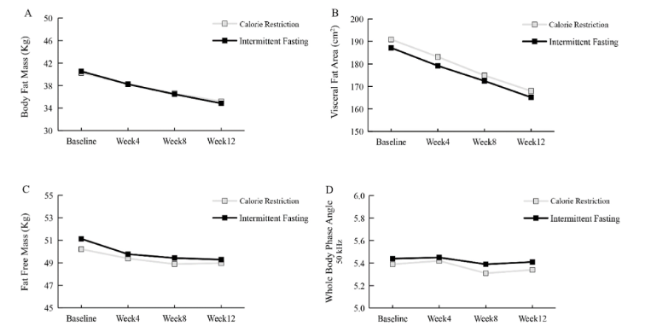
Publications

Slide 51
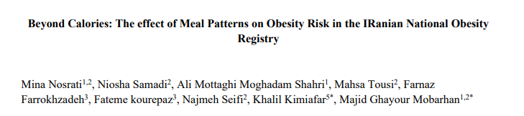
Publications
 | Meal frequency
 | <3 N=656 |  |  | =3 N=2244 | ≥3 N=1273
 | OR | 95%CI | p-value |  | OR | 95%CI | p-value | p-trend
Crude | 1.02 | 0.85- 1.21 | 0.82 | 1 | 0.71 | 0.62 -0.82 | <0.0001 | <0.0001
Model | 1.04 | 0.88-1.25 | 0.52 | 1 | 0.73 | 0.63-0.84 | <0.0001
Model2 | 1.00 | 0.82-1.21 | 0.96 | 1 | 0.80 | 0.69-0.93 | 0.004

Slide 52
Publications
Main meal | BMI≥ 30
Breakfast N=1857 | OR | 95%CI | p-value
Crude | 0.66 | 0.58- 0.74 | <0.0001
Model 1 | 0.66 | 0.58-0.74 | <0.0001
Model 2 | 0.79 | 0.69-0.91 | 0.001
Dinner N=837 | OR | 95%CI | p-value
Crude | 1.18 | 1.01- 1.37 | 0.03
Model 1 | 1.22 | 1.05-1.43 | 0.009
Model 2 | 1.21 | 1.03 – 1.42 | 0.01

Slide 53
Publications
Eating Habits and Obesity: The impact of eating rate and appetite
 | Eating rate
 | Slow N= 549 |  | Moderate N= 2157 | Fast N= 1596
 | OR | 95%CI |  | OR | 95%CI | p-trend
Crude | 0.78 | 0.64 – 0.94 | 1 | 2.12 | 1.86 – 2.42 | <0.0001
Model 1 | 0.73 | 0.60 – 0.89 | 1 | 2.17 | 1.90 – 2.48
Model 2 | 0.67 | 0.53 – 0.83 | 1 | 1.80 | 1.54 – 2.11
Model 1: adjusted for age & gender
Model 2: model 1+ job, physical activity, marital, history of dieting, education level

Slide 54
Publications
Eating Habits and Obesity: The impact of eating rate and appetite
 | Appetite status
 | Low N= 364 |  | Moderate N= 2575 | High N= 1363
 | OR | 95%CI |  | OR | 95%CI | p-trend
Crude | 0.88 | 0.70 - 1.10 | 1 | 2.15 | 1.88 - 2.46 | <0.0001
Model 1 | 0.84 | 0.67 – 1.05 | 1 | 2.17 | 1.90 – 2.49
Model 2 | 0.73 | 0.57 – 0.95 | 1 | 1.88 | 1.61 – 2.20
Model 1: adjusted for age & gender
Model 2: model 1+ job, physical activity, marital, history of dieting, education level

Slide 55
Publications
The association between fast food consumption and obesity and body composition in the Iranian National Obesity Registry (IRNOR)
 | Eating fast food (per month)
 | 1-3 (N= 604) | > 3 (N= 352) | 95%CI | P-value
 | OR
Crude | 1 | 1.39 | 1.05-1.84 | 0.020
Model 1 | 1 | 1.37 | 1.02- 1.83 | 0.035
Model 2 | 1 | 1.58 | 1.09- 2.28 | 0.014
Multivariate logistic regression. P-value <0.05 were considered significant.
Model 1: adjusted for gender & age. Model 2: model 1 + education & job status.

Slide 56
Publications
The association between fast food consumption and obesity and body composition in the Iranian National Obesity Registry (IRNOR)
Variable | β- coefficient | S.E. | t | P-value
Weight (kg) | 0.096 | 1.24 | 3.04 | 0.002
BMI (kg/m²) | 0.098 | 0.42 | 2.69 | 0.007
WC (cm) | 0.112 | 0.91 | 3.38 | 0.001
HC (cm) | 0.100 | 0.63 | 2.85 | 0.004
NC (cm) | 0.098 | 0.33 | 2.83 | 0.005
WHR | 0.088 | 0.004 | 2.66 | 0.008
TBW (L) | 0.058 | 0.40 | 2.46 | 0.014
ICW (L) | 0.052 | 0.22 | 2.49 | 0.013
ECW (L) | 0.054 | 0.14 | 2.38 | 0.017
BFM (kg) | 0.105 | 0.89 | 2.85 | 0.004
FFM (kg) | 0.052 | 0.50 | 2.45 | 0.014
SMM (kg) | 0.052 | 0.29 | 2.49 | 0.013
PhA (kHz) | 0.023 | 0.03 | 0.76 | 0.44
BMC (kg) | 0.041 | 0.03 | 1.88 | 0.06

Slide 57

Policy implications from IRNOR
Promote behavior-focused interventions (slow eating, regular breakfast).
Implement workplace physical activity programs.
Regulate fast-food marketing and density.
Use registry dashboards for local decision-making

Slide 58
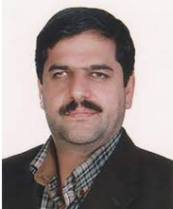



Obesity Registry Committee
Prof. Majid Ghayour Mobarhan
MD.Ph.D. in Nutrition
MUMS
Dr. Khalil Kimiafar
Ph.D. in Health Information Management
MUMS
Prof. Habibollah Esmaiely
Ph.D. in Biostatistics
MUMS
Dr. Mina Nosrati
Ph.D. in Nutrition
MUMS

Slide 59


Obesity Registry Committee
Dr. Majid Jafarnejad
MD.Ph.D. In Traditional Medicine
Deputy Minister of Health of Khorasan Razavi Province
Prof. Roya Kelishadi
MD. Ph.D. In Pediatrics
IUMS

Slide 60



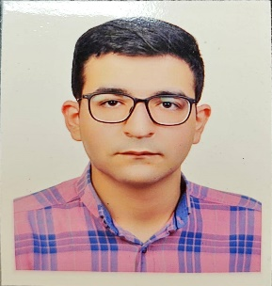
Obesity Registry Committee
Prof. Gordon A.Ferns
MD.Ph.D. in Medical Education and Metabolic Medicine,UK
Dr. Najmeh Seifi
MD.Ph.D. in Nutrition
MUMS
Dr. Omid Emami
Ph.D. In Epidemiology
MUMS
Mr. Amir Ahmadi
Health Information Technology
MUMS

Slide 61



Obesity Registry Committee
Dr. Zahra Abasalti
G.P, MPH;
Head of Community Nutrition Improvement Department,
MUMS
Dr. Nahid Azdaki
MD.Ph.D. In Cardiovascular
BUMS
Dr. Abbas Abdollahi
MD.Ph.D. In General Surgury
MUMS

Slide 62


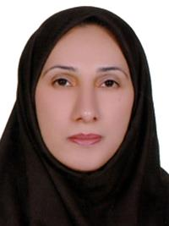
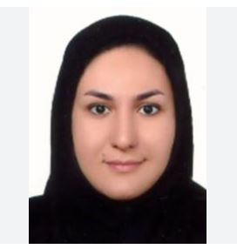
Obesity Registry Committee
Ms. Mahsa Tousi
MSc. in Nutrition
MUMS
Dr Rasoul Alimi
Ph.D. In Statistics
THUMS
Dr. Farkhondeh Razmpour
MD.Ph.D. In Nutrition
BUMS
Dr. Elaheh Foroumandi
Ph.D. In Nutrition
SUMS

Slide 63

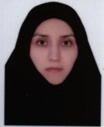

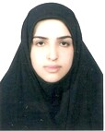
Obesity Registry Committee
Dr. Omid Toupchian
Ph.D. in Nutrition
NKUMS
Dr. Nafiseh Hosseini
Ph.D. in Bioinformatics,
MUMS
Dr Sara Mobarak
MD.Ph.D in Infectious Diseases
AUMS
Dr. Fahimeh Eshghi Malayeri
MD

Slide 64
Thank you

